Slide 1
Uniform Disk Sampling
Jean Paul Huby
Claudia Noche

Slide 2
Topics:
What is Random Disk Sampling?
What types are used?
Implementations
Conclusions

Slide 3
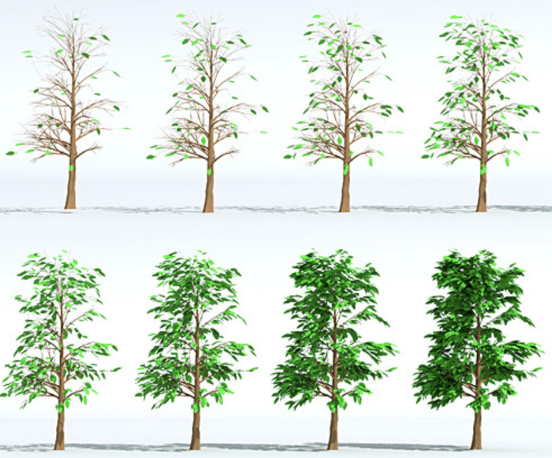
What is Random Disk Sampling
https://medium.com/@hemalatha.psna/implementation-of-poisson-disc-sampling-in-javascript-17665e406ce1
Blue Noise Sample patterns -> all points are at least r distance from each other
A second value of priority is usually added to choose which node is eliminated
A Sequence of tree leaves placed on the surfaces of the branches using weighted sample elimination by Cem Yuksel.

Slide 4
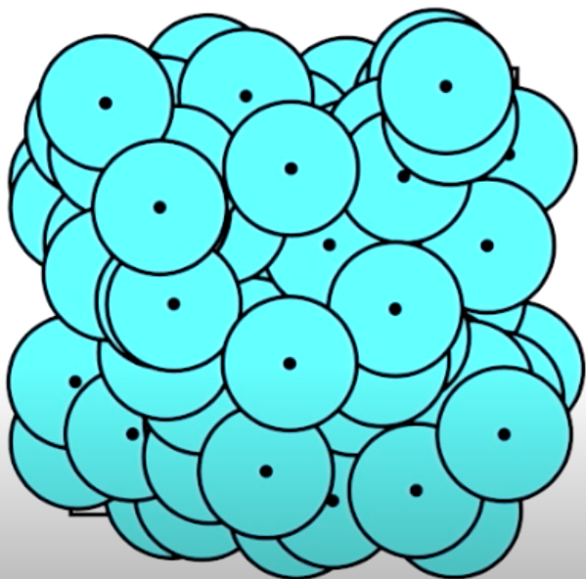
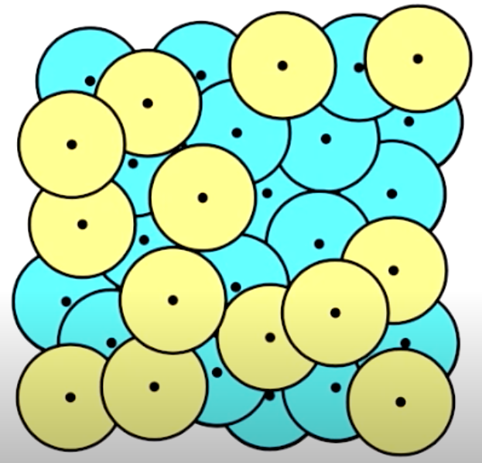
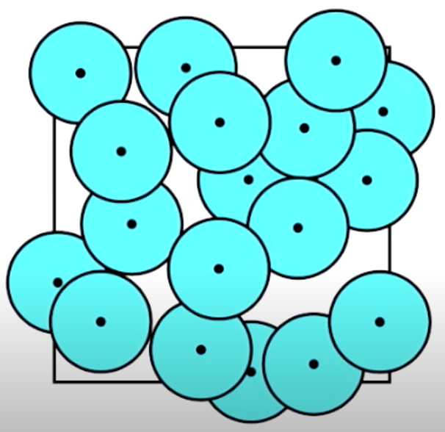
Dart throwing Algorithm - Brute force
https://www.youtube.com/watch?v=G94y3YRqSHk

Slide 5
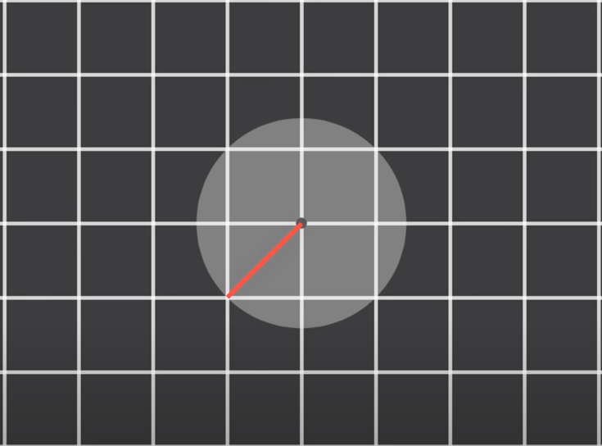
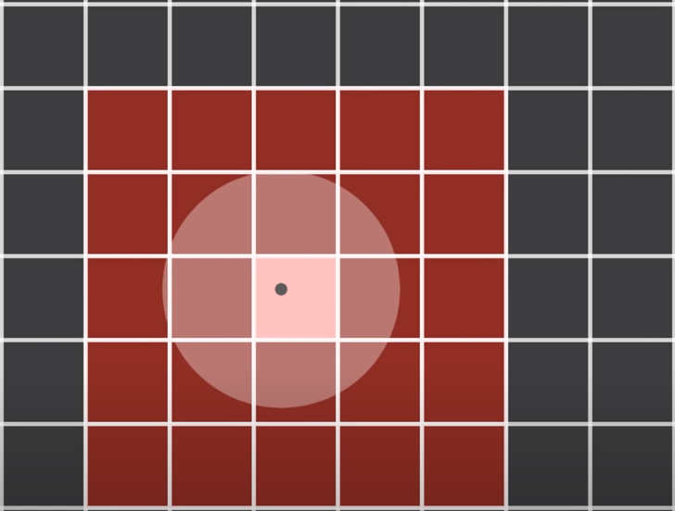
Poisson Disk Sampling
Poisson disk sampling distributes all samples that are uniformly and randomly located.
As opposed to other sampling algorithms, Poisson provides the most uniform results.
The algorithm improves by introducing a grid.
An Intrinsic Algorithm for Parallel Poisson Disk Sampling on Arbitrary SurfaceS
https://www.youtube.com/watch?v=7WcmyxyFO7o

Slide 6
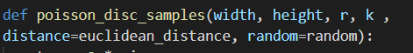
Poisson Disk Sampling: Implementations
Step 0 : Initialize an n-dimensional background grid for storing samples and accelerating spatial searches. We pick the cell size to be bounded by r/√ n
Step 1 : Select the initial sample, x0, randomly chosen uniformly from the domain. Insert it into the background grid, and initialize the “active list”
Step 2 : While the active list is not empty, choose a random index from it (say i). Generate up to k points chosen uniformly from the spherical annulus between radius r and 2r around xi. If a point is adequately far from existing samples, emit it as the next sample and add it to the active list.
Input:
where:
r: = minimum distance
k = number of samples
Fast Poisson Disk Sampling in Arbitrary Dimensions

Slide 7
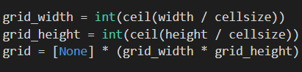
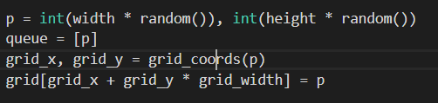
Poisson Disk Sampling: Implementations
Step 0 : Initialize an n-dimensional background grid for storing samples and accelerating spatial searches. We pick the cell size to be bounded by r/√ n. the default −1 indicates no sample
0
0
1
2
3
4
5
6
7
8
9
10
11
Step 1 : Select the initial sample, x0, randomly chosen uniformly from the domain. Insert it into the background grid, and initialize the “active list”
-1
-1
-1
-1
-1
-1
-1
-1
-1
-1
-1
-1

Slide 8
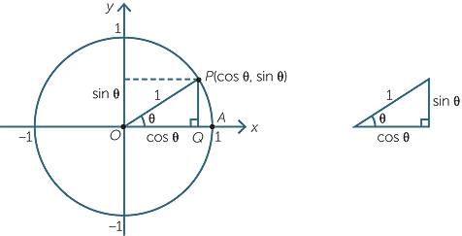
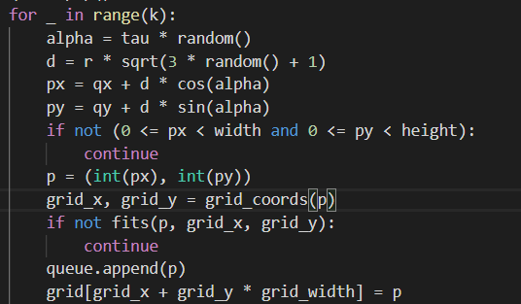
Poisson Disk Sampling: Implementations
Step 2 : While the active list is not empty, choose a random index from it (say i). Generate up to k points chosen uniformly from the spherical annulus between radius r and 2r around xi. If a point is adequately far from existing samples, emit it as the next sample and add it to the active list.

Slide 9
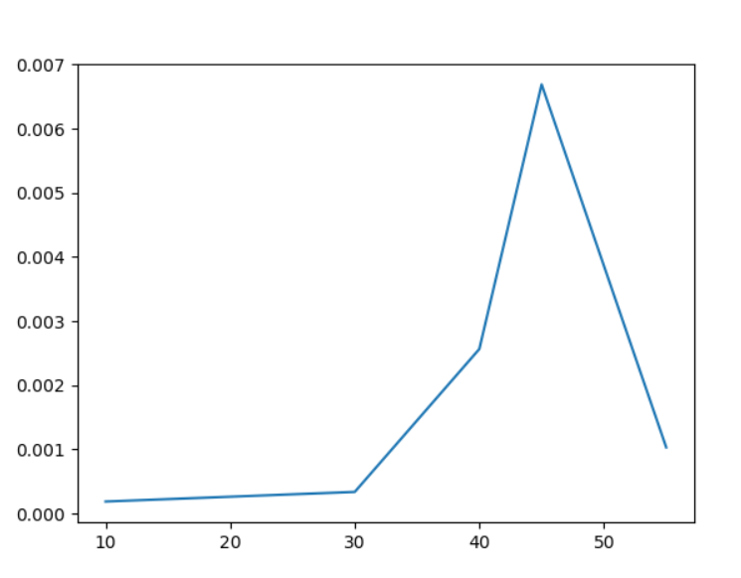
Poisson Disk Sampling: Performance
Given the Input:
where:
r: = 9
width = 1200
height = 700
we know that Step 2 is executed exactly 2N−1 times to produce N. Each iteration of step 2 takes O(k) time, and since k is held constant (typically quite small) the algorithm is linear.

Slide 10
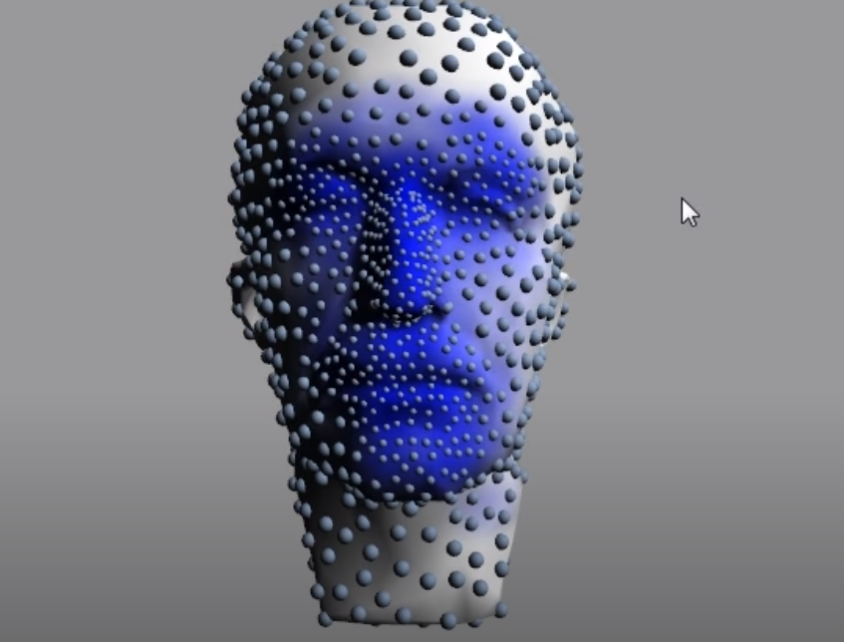
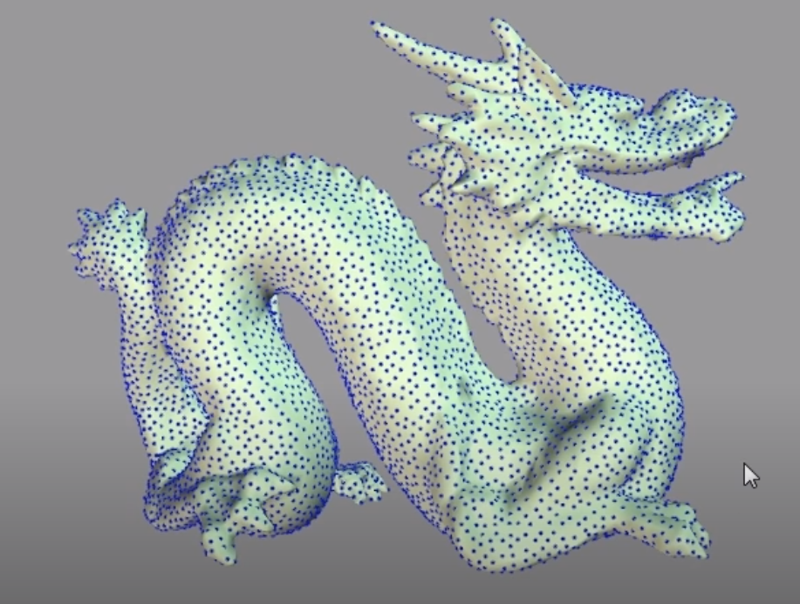
Where is it used?
Visual Computing Applications → Antialiasing, global illumination, non-photorealistic rendering, remeshing, texture synthesis, vector field visualization
https://www.youtube.com/watch?v=NGBi93q0Ydc

Slide 11
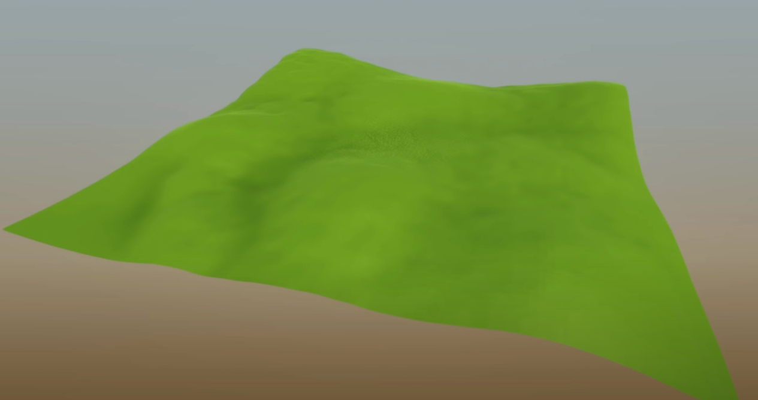
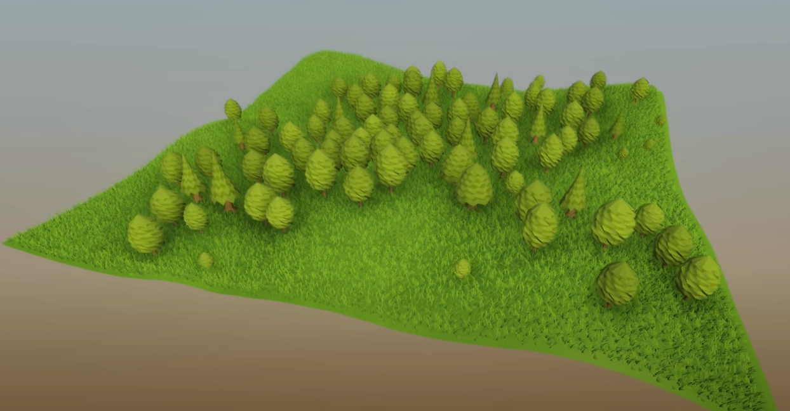
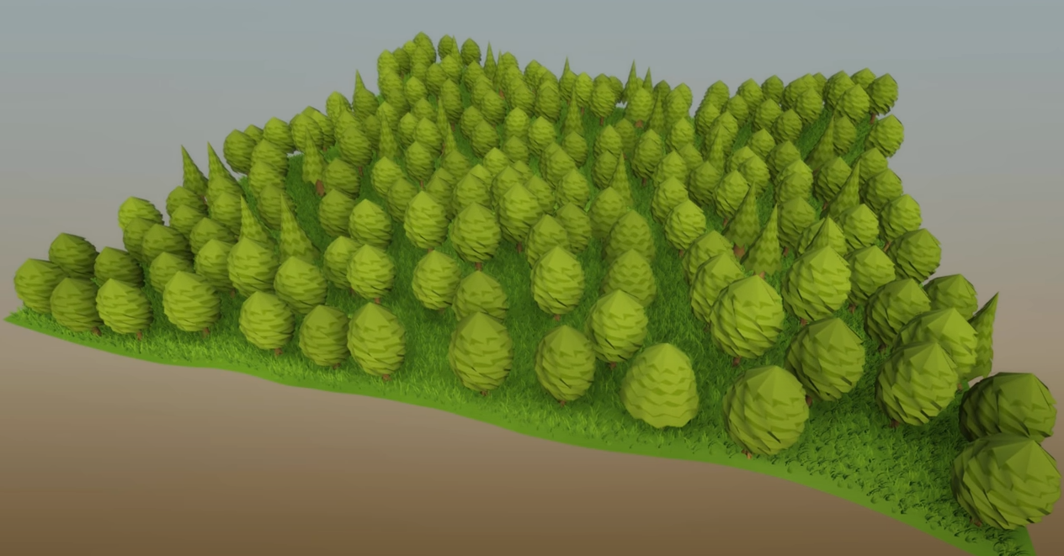
Placement of objects on a surface

Slide 12
Conclusions
Dart throwing to Poisson → different approaches to the same problem.
Importance of Parallelism → Poisson’s Implementations make use of parallelism to get better results.
The wide applications of Poisson’s Algorithm helps show the importance of how one improved algorithm can have a massive effect on a field.

